Slide 1
Detection of Pneumonia from Chest X-ray Images Using Convolutional Neural Networks and Primary Treatment Suggestion Pneumonia Detection from Chest X-ray Images Using a Lightweight CNN Model with Integrated Clinical Guidance
MD PARVEZ ALAM KHAN ABIR
ULSTER UNIVERSITY
Abir-MPAK@ulster.ac.uk

Slide 2
Table of contents
Introduction
Aims &Objectives
Literature Review
Methodology
Results & Comparison
Discussion & Future work
Conclusion

Slide 3
Introduction

Slide 4
Introduction
Pneumonia: a leading cause of child mortality worldwide
Over 800,000 child deaths annually (WHO)
Early detection is critical to reduce mortality
Chest X-rays are standard for diagnosis but require expert interpretation
AI, specifically CNNs, offers accurate, scalable, and efficient detection

Slide 5

Problem Statement
Pneumonia diagnosis primarily relies on chest X-rays, which require skilled interpretation by trained radiologists.
Manual reading of X-ray images is often slow and prone to human errors, potentially delaying accurate treatment.
Many low-resource regions face a severe shortage of radiologists, making timely and reliable diagnosis a significant challenge.

Slide 6

Aims & Objectives
Develop a lightweight, custom CNN capable of accurately detecting pneumonia from pediatric chest X-rays.
Ensure high efficiency so the model can run on devices with limited computational resources.
Integrate rule-based clinical support to provide actionable guidance for healthcare professionals.
Enable deployment in low-resource settings, improving access to timely and reliable pneumonia diagnosis.

Slide 7
Literature Review
Pre-trained Models:
CheXNet (DenseNet121): AUC 0.76 – accurate but resource-heavy.
InceptionV3: ~92.8% accuracy – effective but computationally expensive.
Other Approaches:
Ensemble Models: Combine multiple networks to achieve high accuracy (~96.4%) but are complex and resource-intensive.
Custom CNNs: Offer simpler architectures and faster inference times, making them more deployable in practical scenarios.
Limitations: Often lack interpretability and detailed clinical support, which reduces their real-world usability.
Research Gap:
Existing solutions struggle to balance accuracy, efficiency, and explainability
There is a need for models that are lightweight, accurate, and interpretable for deployment in low-resource clinical environments.

Slide 8
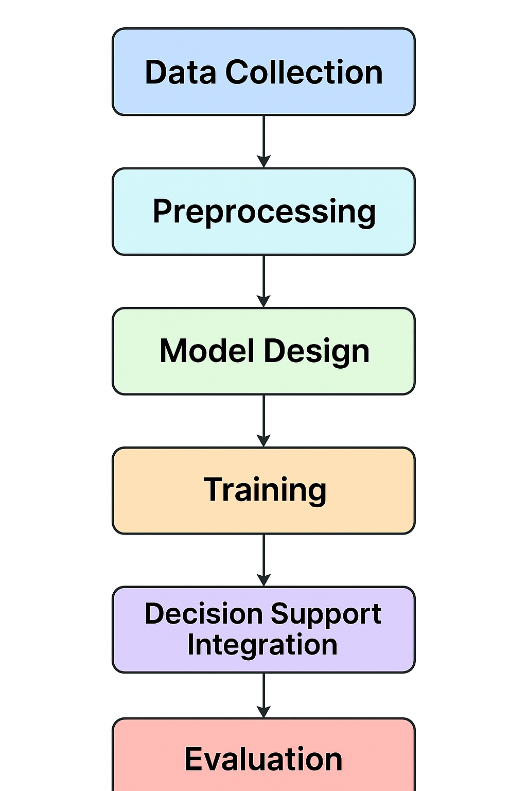
Methodology
Data Collection:
5,856 pediatric chest X-ray images
Two classes: Normal and Pneumonia
Includes both AP and PA views
Preprocessing:
Images resized to 256 × 256 pixels
Pixel values normalized to 0–1 scale
No augmentation for baseline reproducibility

Slide 9
Methodology
Model Design:
Custom lightweight CNN with sequential layers: Conv → Pool → BatchNorm → Dropout → Dense
~45,000 parameters for efficiency
L2 regularization and dropout to reduce overfitting
Training Setup:
Optimizer: Adam, Loss: Binary cross-entropy
400 epochs with early stopping to prevent overfitting
Decision Support Integration:
Rule-based logic integrated to suggest clinical guidance
Extends the model from detection to actionable insights

Slide 10
Methodology
Evaluation:
Measure accuracy
Precision
Recall
F1-score

Slide 11
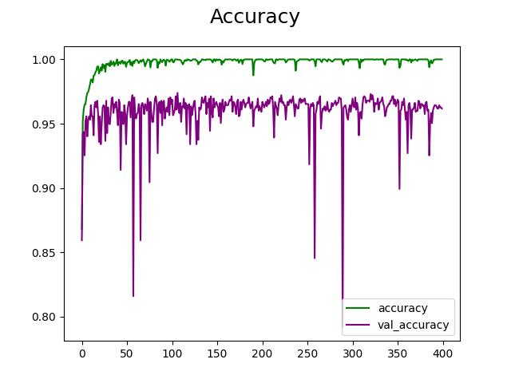
Results
Performance:
Accuracy: 96.7%
Precision: 97.9% – strong reliability in positive predictions
Recall: 97.7% – pneumonia cases rarely missed
F1-score: 97.3% – balanced performance

Slide 12
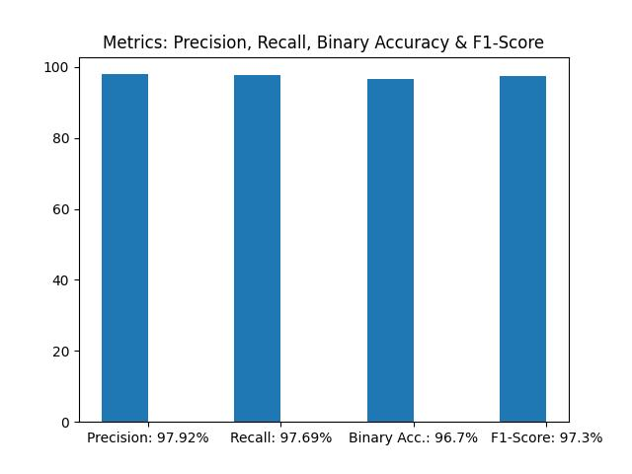
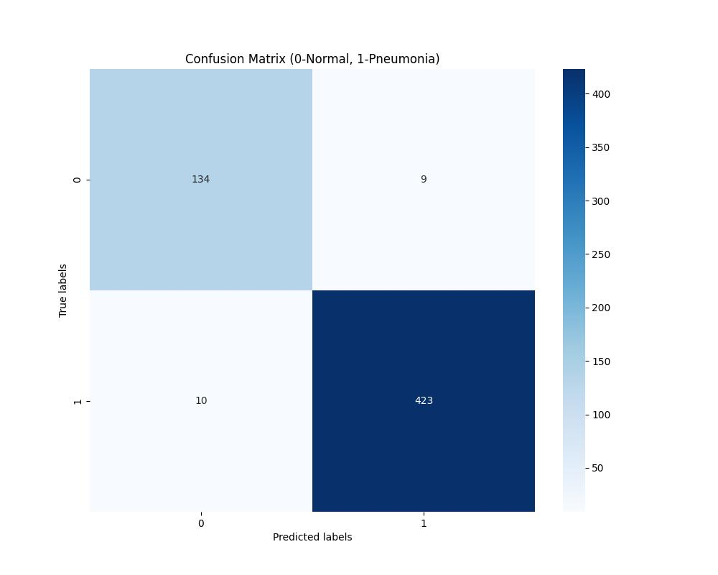
Results
Training & Validation:
Smooth convergence with early stopping
No major signs of overfitting
Confusion Matrix:
High true positives, very low false negatives and false positives
Key Point:
Lightweight CNN is accurate, efficient, and clinically reliable

Slide 13
Comparison with Existing Models
Model | Accuracy | Complexity | Deployment Feasibility
CheXNet | High (AUC 0.76) | Very heavy (DenseNet121) | Limited – needs high resources
InceptionV3 | ~92.8% | Computationally expensive | Difficult in low-resource settings
Ensembles | ~96.4% | Complex, multi-model | Slow and resource-hungry
Proposed CNN | 96.7% | Lightweight (~45k params) | Efficient, deployable, explainable

Slide 14
Discussion
Discussion:
Proposed CNN achieved high accuracy (96.7%) while remaining lightweight and efficient.
Integration of rule-based decision support extends utility beyond detection into clinical guidance.
Strong results indicate potential for real-world use in low-resource settings.
Limitation: current model handles only binary classification (Normal vs Pneumonia) and lacks advanced interpretability.

Slide 15
Limitations
External Validation Missing: Model tested only on one dataset; generalizability unproven.
Explainability Gap: No Grad-CAM or saliency maps to show decision reasoning.
Demographic Bias Risk: Dataset may not reflect global population diversity.
Binary Classification Only: Cannot distinguish between bacterial vs. viral pneumonia.
Clinical Integration Needed: No real-world deployment or radiologist evaluation yet.

Slide 16
Future Work
Future Work
Incorporate Grad-CAM or similar methods to improve explainability.
Extend model to multi-class classification (different pneumonia types, other lung diseases).
Validate with larger and more diverse datasets across regions.
Explore mobile and edge deployment for real-time use in clinics.

Slide 17
Conclusion
Summary
Developed a lightweight custom CNN for pneumonia detection.
Achieved high accuracy and reliability while remaining computationally efficient.
Integrated clinical decision support to bridge diagnosis and treatment guidance.
Impact
Offers a practical solution for healthcare in low-resource settings.
Strengthens the role of AI as an assistive tool, not a replacement for clinicians.
Demonstrates how simplicity + interpretability can rival complex models.

Slide 18
Thanks!
Any questions?
MD PARVEZ ALAM KHAN ABIR
ULSTER UNIVERSITY
Abir-MPAK@ulster.ac.uk

